Slide 1
ICTs and Enterprise Level Value creation

Slide 2
Enterprise Resource Planning (ERP) System
What Is Enterprise Resource Planning (ERP)?
Enterprise resource planning (ERP) is a process used by companies to manage and integrate the important parts of their businesses. Many ERP software applications are important to companies because they help them implement resource planning by integrating all of the processes needed to run their companies with a single system. An ERP software system can also integrate planning, purchasing inventory, sales, marketing, finance, human resources, and more.
ERP applications also allow the different departments to communicate and share information more easily with the rest of the company. It collects information about the activity and state of different divisions, making this information available to other parts, where it can be used productively.

Slide 3
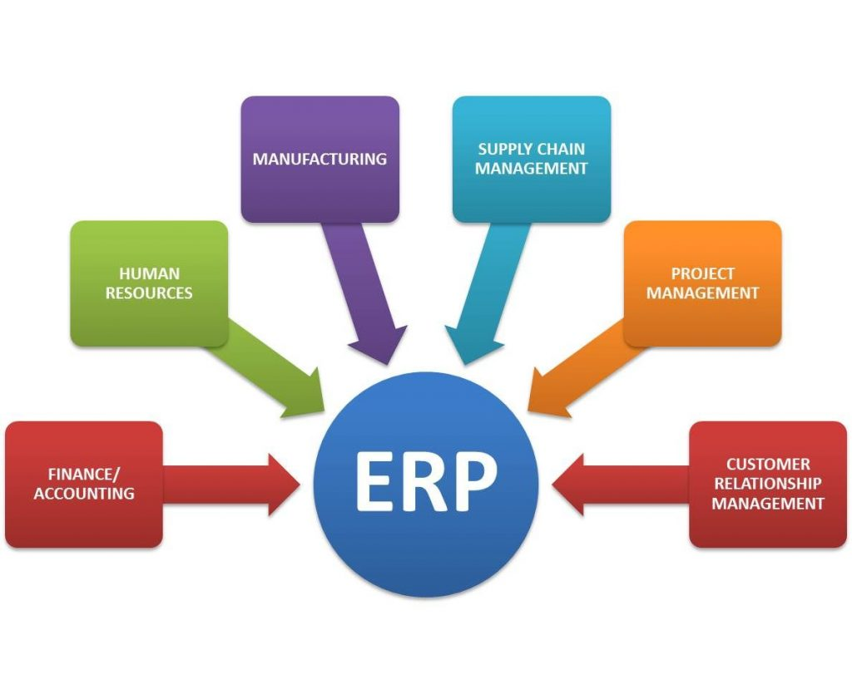
Enterprise Resource Planning (ERP) System
ERP software can integrate all of the processes needed to run a company.
ERP solutions have evolved over the years, and many are now typically web-based applications that users can access remotely.
Some benefits of ERP include the free flow of communication between business areas, a single source of information, and accurate, real-time data reporting.
An ERP system can be ineffective if a company doesn't implement it carefully.

Slide 4
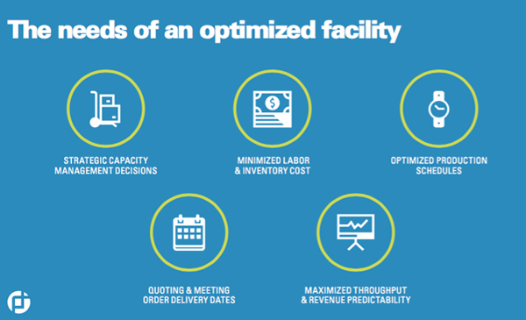
5 Benefits of an Enterprise Resource Planning (ERP) System

Slide 5
The business value of ERP
Improved business insight from real-time information generated by reports
Lower operational costs through streamlined business processes and best practices
Enhanced collaboration from users sharing data in contracts, requisitions, and purchase orders
Improved efficiency through a common user experience across many business functions and well-defined business processes
Consistent infrastructure from the back office to the front office, with all business activities having the same look and feel
Higher user-adoption rates from a common user experience and design
Reduced risk through improved data integrity and financial controls
Lower management and operational costs through uniform and integrated systems

Slide 6
Cloud ERP—A new ERP delivery model
Software-as-a-service (SaaS) Enter the cloud—specifically, the software-as-a-service (SaaS) delivery model for ERP. When ERP software is delivered as a service in the cloud, it runs on a network of remote servers instead of inside a company’s server room. The cloud provider patches, manages, and updates the software several times a year—rather than an expensive upgrade every 5 to 10 years with an on-premises system. The cloud can reduce both operational expenses (OpEx) and capital expenses (CapEx) because it eliminates the need for companies to purchase software and hardware, or hire additional IT staff. These resources can instead be invested in new business opportunities, and the organization is always up-to-date on the most recent ERP software. Employees can shift their focus from managing IT to more value-added tasks such as innovation and growth.

Slide 7
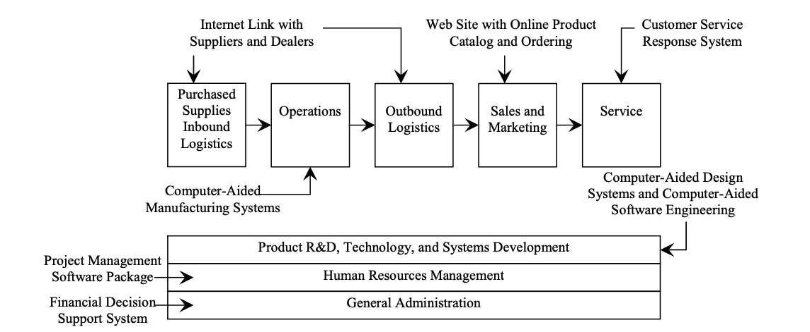
ERP : Benefits and Economic Effectiveness

Slide 8
Customer Relationship Management (CRP)
What does a CRM system do?
A customer relationship management (CRM) solution helps you find new customers, win their business, and keep them happy by organizing customer and prospect information in a way that helps you build stronger relationships with them and grow your business faster.

Slide 9
Why CRM Benefits Businesses
Having customer information such as past purchases and interaction history easily accessible can help customer support representatives provide better and faster customer service.
Collection of and access to customer data can help businesses identify trends and insights about their customers through reporting and visualization features.
Automation of menial, but necessary, sales funnel and customer support tasks.

Slide 10
Components of CRM
Marketing automation
Sales force automation
Contact center automation
Geolocation technology, or location-based services
Workflow automation
Lead management
Human resource management
Analytics
Artificial intelligence
Project management
Integration with other software

Slide 11
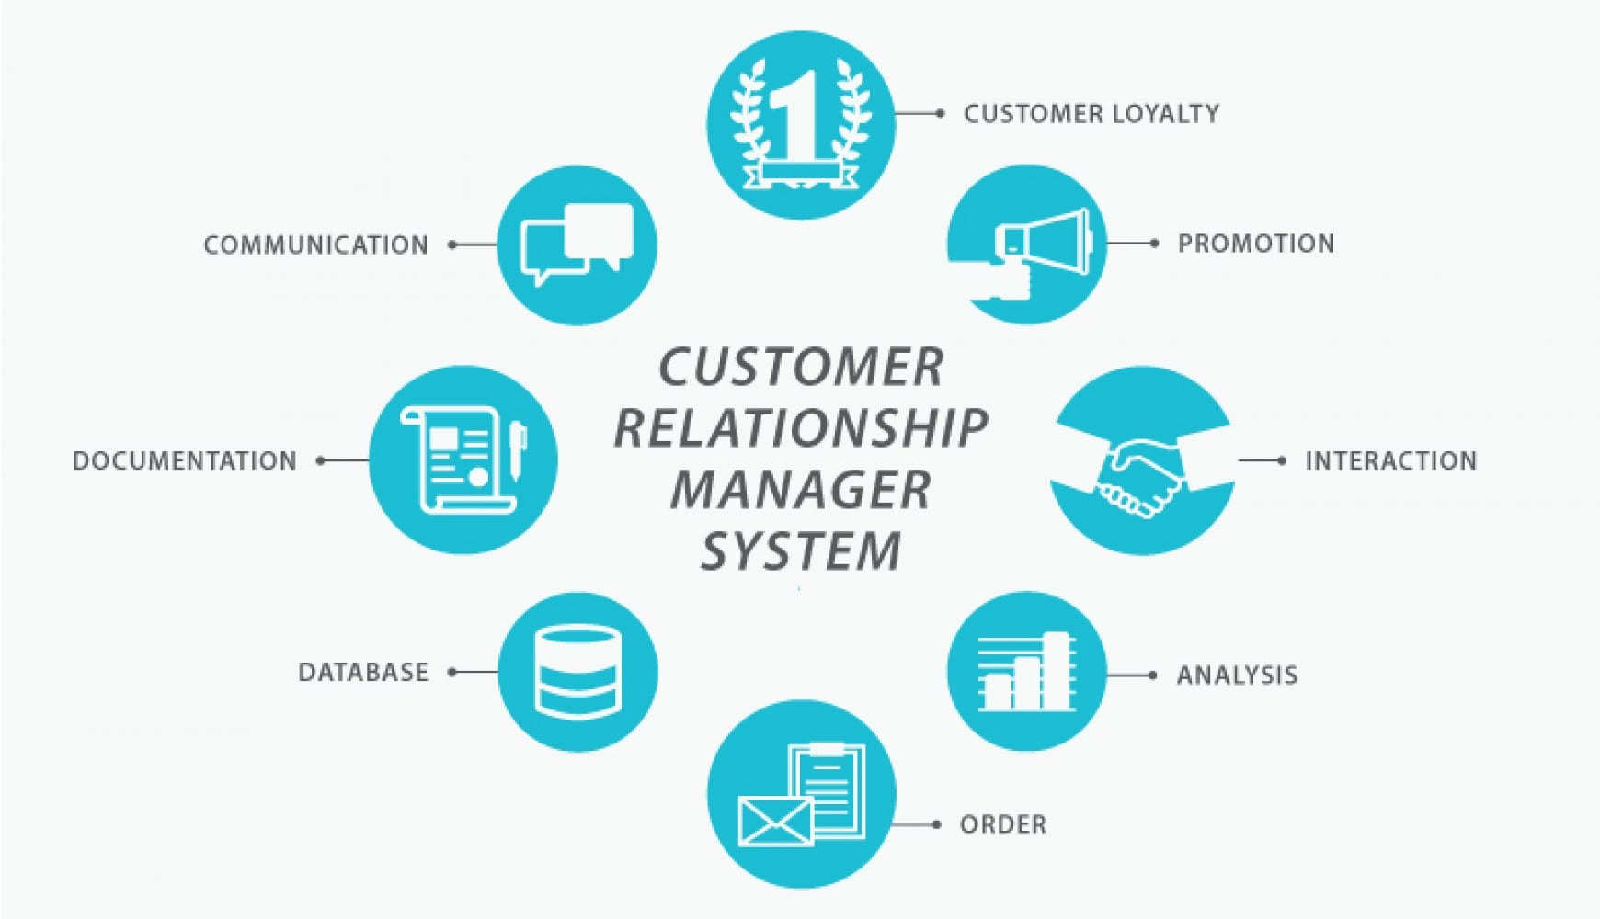
Need of CRM

Slide 12
Need of CRM
Centralised Information – How many new client prospect telephone calls do your lawyers make each day? Does everyone who communicates with a client know what other practice groups said to them or did for them? Is all client information kept in one area or program for easy client service reference? Do you have several databases of information that you need access for a 360 degree client view?
Quality Data – Are you able to identify (let alone manage) the top 10% of clients that give you 90% of your revenue? Do you know what is happening with each of these clients “real-time” – for example, leadership changes, new acquisitions, new product or service offerings?
One View Of The Client – Are you able to access all the information you need from one screen? What is your revenue per lawyer, per BDM, per marketer? What are your win, loss and no-decision rates? What’s your matter turnaround time? How many business development calls are completed per lawyer? What’s the average amount of time required to complete each step in developing a new major client? Do you know how many client service issues each client has had and why? Do you know which clients consume most of your lawyers (billable vs unbillable) time?

Slide 13
Need of CRM
4. Ongoing Client Care – What is the workload by practice group or by lawyer? What are the numbers of existing client contacts and repeat business? What’s the average matter size, billing and payment frequency? How do you rate your marketing or lead generation program / marketing event effectiveness? What are the win-rate comparisons for different client types?
5. Cloning Our Best Rain Makers – What are the success rates and profitability comparisons for individual partners and lawyers? Can you communicate quickly with message broadcasts to your client base?
6. Risk Management (High Availability/Disaster Recovery) – what happens when a key rain maker leaves the firm? Do you have critical client data on PC’s that could be lost or taken and should be on one database?

